Slide 1
Chapter 15
Performance Measurement

Slide 2
Objectives
After studying this topic you should be able to:-
Understand the need for a range of measures to monitor businesses
Describe and critical evaluate the main performance measurement frameworks
Appreciate the developments in this area and understand the links to strategic management accounting.
Understand the practice and value of benchmarking in specific industry sectors

Slide 3
Performance Measurement Development
There has been increasing recognition that measuring performance requires more than just a financial focus, increasingly businesses use a range of metrics to provide a broad view of business performance.

Slide 4
Problems with Financial Performance measures
Short term
Narrowly focused
Internally orientated
Backward looking
Lag measures
(Eccles 1991, Kaplan and Norton 1992)

Slide 5
Key frameworks and models
Results and determinant model
Balanced scorecard
The performance prisim

Slide 6
Results and Determinants model (1) Results
Performance dimensions | Types of measures
Competitiveness | Relative market share and position Sales growth Measures of the customer base
Financial performance | Profitability Liquidity Capital structure Market ratios
(Adapted from Fitzgerald et al 1991:8)

Slide 7
Results and Determinants model (2) Determinants
Performance dimensions | Types of measures
Quality of service | Reliability, Responsiveness, Aesthetics/ appearance, Cleanliness/tidiness, Comfort, Friendliness, Communication, Courtesy, Competence, Access, Availability, Security
Flexibility | Volume flexibility, Delivery speed flexibility Specification flexibility
Resource utilisation | Productivity Efficiency
Innovation | Performance of the innovation process Performance of individual innovators
(Adapted from Fitzgerald et al 1991:8)

Slide 8
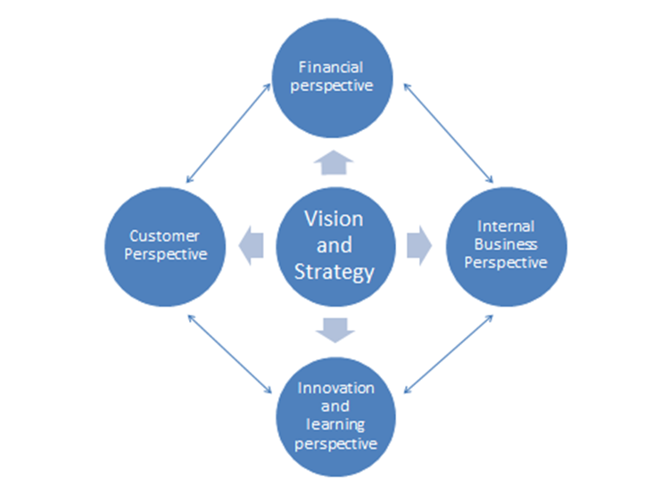
Balanced Scorecard
(adapted from Kaplan and Norton, 1996)

Slide 9
Departmental scorecard for conference and events

Slide 10
Causal Links in the Balanced Scorecard

Slide 11
Performance Prism
Source: Adapted from Neely et al (2002)

Slide 12
Example Hotel Scorecard
Dimension | Key Objectives | Areas to be monitored
Financial | Hotel Profitability Sales | GOPPar; ROCE RevPar, occupancy, ADR
Customer | Customer satisfaction Loyalty Scheme | Customer satisfaction survey No of Loyalty Scheme Members
Internal Business | Sales development Brand standards | No of staff completed customer care training Mystery Guest scores
Innovation and Learning | Sustainable business Hotel development | Energy usage and recycling statistics. No of new operating contracts

Slide 13
Example Airline Scorecard

Slide 14
Events Performance Prism
Prism facet | Example of Objectives | Performance Measure
Stakeholders’ wants | Charity engagement | Number of charity partners
Strategies | Increase image and awareness of event | Amount of media coverage, increase in ticket sales
Processes | Project management and logistics | Customer satisfaction survey covering operational aspects
Capabilities | People – make event attractive to volunteers and employees | Application to Recruitment ratio
Stakeholder contribution | Artists – maximise impact and satisfy fan base | Customer satisfaction, positive media reviews

Slide 15
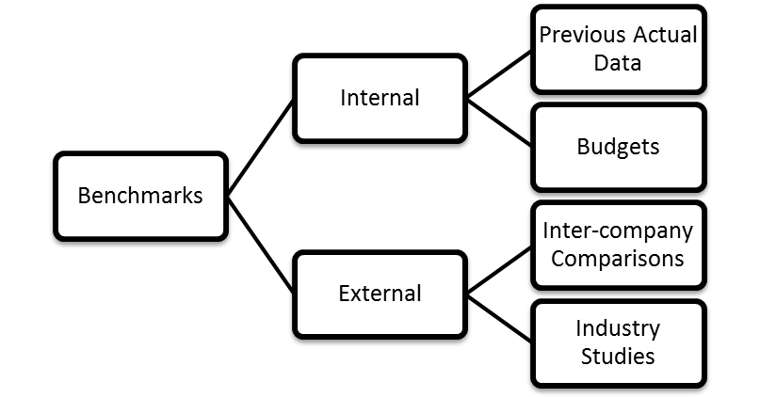
Benchmarking

Slide 16
Benchmarking - Internal
Previous Actual Data (weekly, monthly, annual)
It is your own data, presented in a consistent manner
Relates to same location/unit/department
Assumes previous data is ‘normal’, this may not be the case due to changes in operation, events, etc.
Internal Budget Data
Overcomes some disadvantages of previous data as prepared for the same time period
Still only an internal view, ignore competition/market place

Slide 17
Benchmarking - External
Intercompany comparisons
Comparing to competitor data (or non-competing indicator firm)
Never the identical size, location, so are you comparing ‘like-with-like’? USALI can aid with this so it is meaningful.
Industry studies and reports
A number of published industry reports, often from consultancy companies can give a sound external indicator, if aware of the issue of ‘like-with-like.

Slide 18
Summary
To recognised that performance measurement systems are designed to link operations to strategy
That a range of financial and non-financial measures should to be combined in any scorecard.
Benchmarking is a very powerful management tool
When comparing figures it is important to compare like with like

